Slide 1
Classification Of Iris Species using R
Shreya Chippagiri - 1PI10IS134
Surabhi R - 1PI10IS109

Slide 2
INTRODUCTION
RStudio: a free and open source integrated development environment(IDE) for R.
R: a programming language for statistical computing, data mining and graphics.graphics.

Slide 3
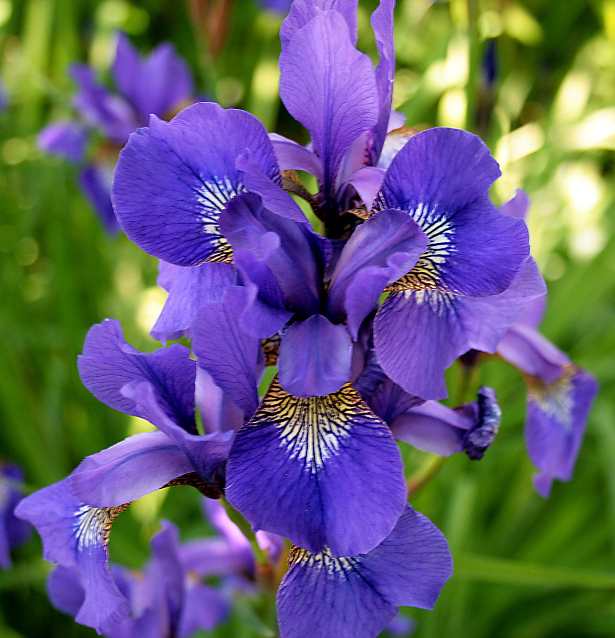
The IRIS Dataset:
The Iris Data Set or Fisher’s Iris data set is a multivariate data set introduced by Ronald Fisher in 1936. The dataset consists of 50 samples from each of three species of Iris flowers (Iris setosa, Iris virginica and Iris versicolor). Four attributes were measured from each sample. These attributes are the length and the width of sepal and petal, in centimeters. Based on the combination of the four features most Machine Learning Methods can learn to distinguish among the irises. There are no missing values.

Slide 4
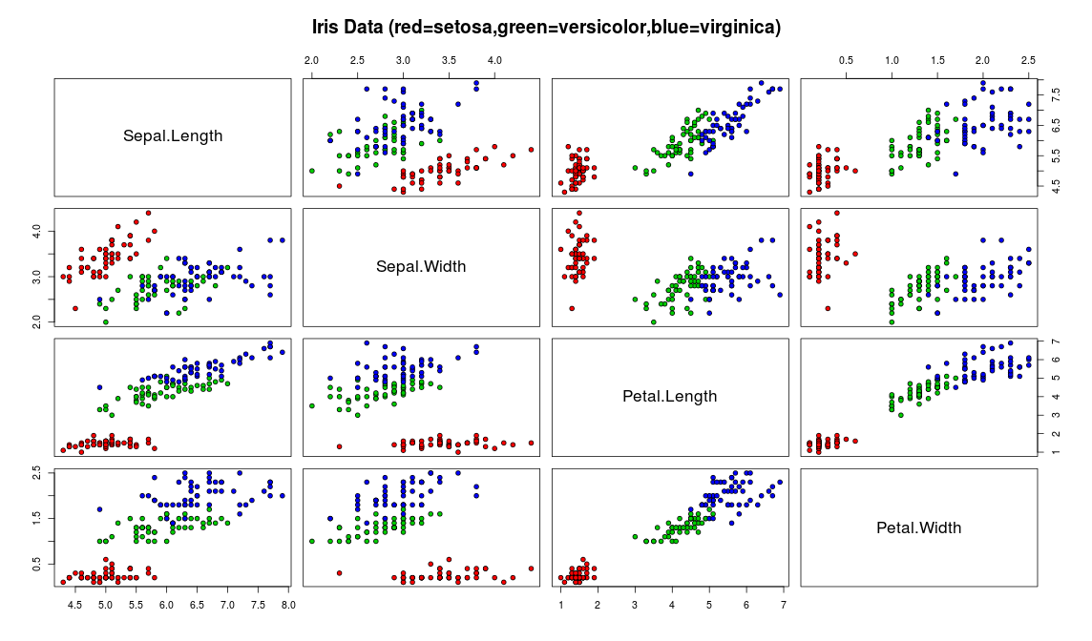
DATA VISUALIZATION
Scatterplot:

Slide 5
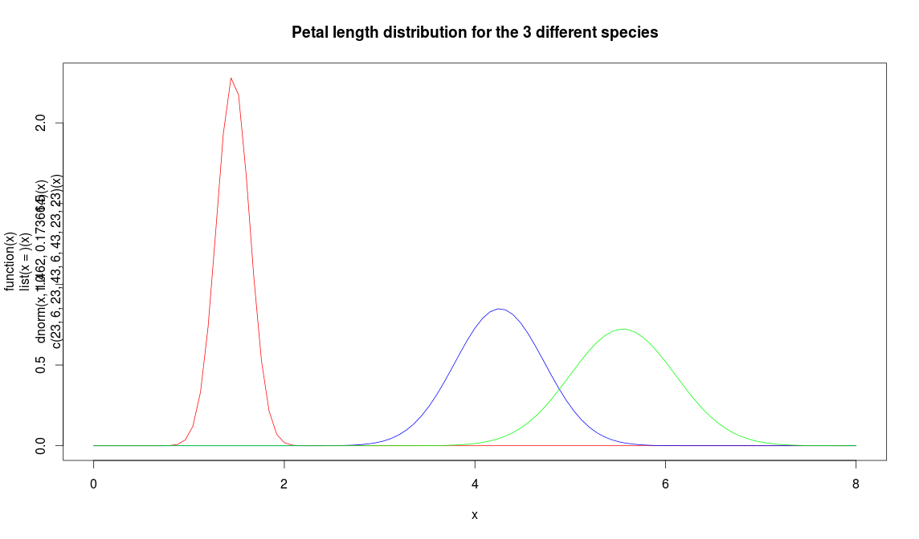
Plot Distribution Curve:

Slide 6
CLASSIFICATION
Naive Bayesian Classification:
A simple probabilistic classification algorithm based on Bayes’ theorem that assumes class conditional independence.
It consists of a training set,test set and unknown data set to predict using the classifer.

Slide 7
PROBLEM STATEMENT
The Iris dataset is pre-installed in R, since it is in the standard datasets package. As mentioned , there are 150 data points and 5 variables. Each datapoint concerns a particular iris flower and gives 4 measurements of the flower: Sepal.Length, Sepal.Width, Petal.Length and Petal.Width together with the flower's Species: Setosa,Versicolor,Verginica. The goal is to build a classifier that predicts species from the 4 measurements, so species is the class variable.

Slide 8
STEPS
Load the required packages
View the IRIS dataset
View a summary of the dataset
Sepal.Length Sepal.Width Petal.Length Petal.Width Min. :4.300 Min. :2.000 Min. :1.000 Min. :0.100 1st Qu.:5.100 1st Qu.:2.800 1st Qu.:1.600 1st Qu.:0.300 Median :5.800 Median :3.000 Median :4.350 Median :1.300 Mean :5.843 Mean :3.057 Mean :3.758 Mean :1.199 3rd Qu.:6.400 3rd Qu.:3.300 3rd Qu.:5.100 3rd Qu.:1.800 Max. :7.900 Max. :4.400 Max. :6.900 Max. :2.500
Species setosa :50 versicolor:50
virginica :50

Slide 9
Build the naive bayes classifier based on the training set
Get the mean and standard deviation of each of the 4 attributes
- Note that there is less variation in petal length of Setosa (standard deviation is only 0.1736640)
Petal.Length iris[, 5] [,1] [,2] setosa 1.462 0.1736640 versicolor 4.260 0.4699110 virginica 5.552 0.5518947

Slide 10
Plot the Gaussian class distribution curves for each of the classes
Note that setosa irises (the red curve) tend to have smaller petals (mean value = 1.462)
Predict using the classifier

Slide 11
RESULT
The classifier gives an accuracy of 97%.
setosa versicolor virginica setosa 50 0 0 versicolor 0 47 3 virginica 0 3 47

Slide 12
THANK YOU!

